Slide 1
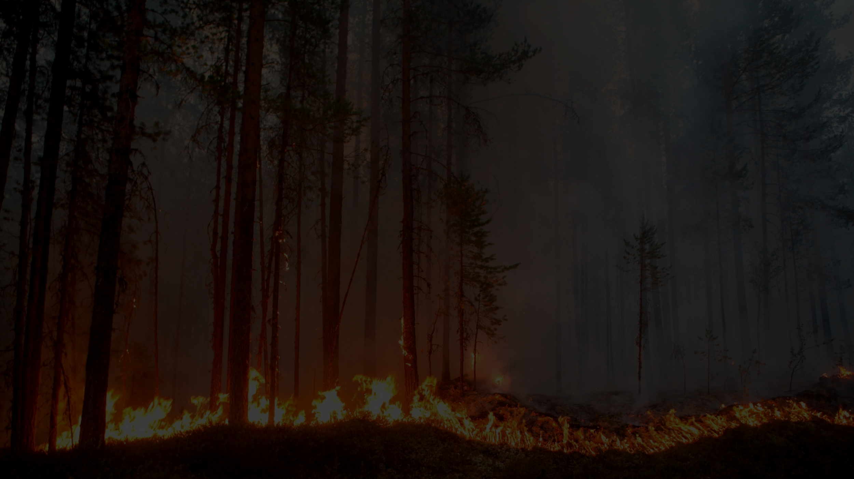

Wildfires Tamed - Cooling the Roots
By Aditi G, Anna T, Ali H, Brandon T, Sanya K
Mentor: Veronica Donato

Slide 2







Junior Academy Team
Wildfires are a prominent issue affecting the world today. As an innovative group of individuals from different parts of the globe, we hope to use our diverse problem solving skills to improve the response time of wildfires. We have explored a plethora of possible solutions and believe that our natural curiosity and tenacity will lead to a real technological impact.
“To myself I am only a child playing on the beach, while vast oceans of truth lie undiscovered before me.”
Isaac Newton

Slide 3
Problem
Wildfires ravage through rural vegetation due to the large amounts of dry wood and leaves present. Any air current also stokes the fire in any direction, exacerbating the damage. By the time a response team of firefighters assembles and reaches the site, the wildfire has spread significantly over a large area. The delayed response time and inability to lower temperatures immediately causes the fire to turn rogue and become uncontrollable.
40 Million km² of the global land surface affected by wildfires per year.
Over 105,000 wildfires in North America every year.
Over 670,000 forest fires in China over 50 years.
250,000 wildfires burning at any given moment in Africa.

Slide 4
Background
Our research showed us that although highly detailed weather models are being used to analyze how the fire will develop when it is already ablaze, there is no system to predict it.
To predict wildfires, we must consider 3 main factors - humidity, temperature, and Carbon Monoxide emissions. Our project synthesizes all three sources of data, using a multi-factor approach to accurately and preemptively determine the possibility of a wildfire.
CARBON MONOXIDE
HUMIDITY
TEMPERATURE

Slide 5
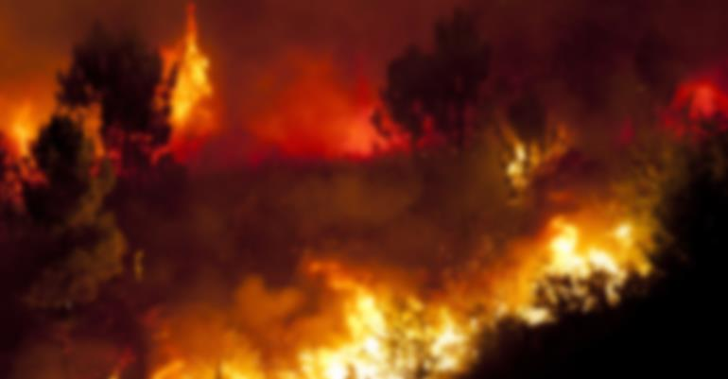
Long-Term Effects
Forests & dense vegetation are a small ecosystem on their own. The destruction of these habitats disturbs key landscape stressors. We must also remember that some wildfires are a natural phenomenon and are beneficial to the environment in the long-run. Wildfire smoke is quick to disburse and can travel long distances, affecting thousands of people on its route.

Slide 6
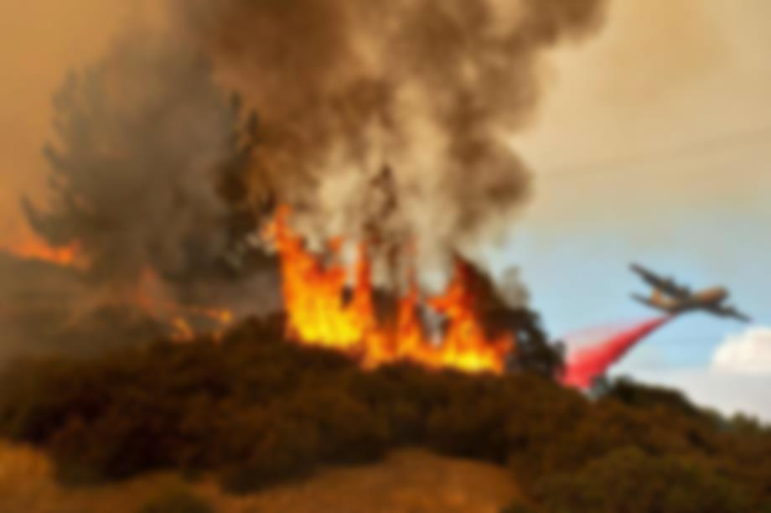
Landscape Stress
Soil parent material is an indirect but strong mediator of the effects of post-fire vegetation on soils in this region, especially with respect to soil P changes, which vary substantially between andesite- and granite-derived soils.

Slide 7
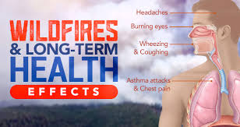
Health Effects
Chronic exposure to smoke, year-in and year-out can lead to long-term health problems, especially for people with underlying heart and lung problems, children, pregnant women. and senior citizens. It also leads to chronic cardiovascular diseases, e.g., heart attacks (both fatal and non-fatal), irregular heartbeats and increased severity of asthma whereas for others, it can induce asthma-like symptoms.
Carbon monoxide and small particulate matter (PPM 2.5) are the most dangerous. They get embedded deep in the lungs and cause irritability, shortness of breath and magnify any pre-existing issues.

Slide 8
Prediction Approach
What is our purpose?
We want to track, prevent, and contain wildfires before they turn rogue using autonomous technology. Our project would efficiently monitor the wildfire, help search & rescue teams and quicken response time.
What is our project? How does it work?
We are creating a sensor device capable of detecting the concentration of Carbon Monoxide, percentage of humidity, and levels of temperature. If the detected CO concentration surpasses a certain threshold, the humidity lowers below a percentage threshold,, and the temperature is also above a certain level, our device will display an alert that the area has become a potential wildfire hotspot. Our device will also be low-cost and can be scattered over a large area to keep the reading accurate.
HUM
TEMP
RISK
ALERT
CO

Slide 9
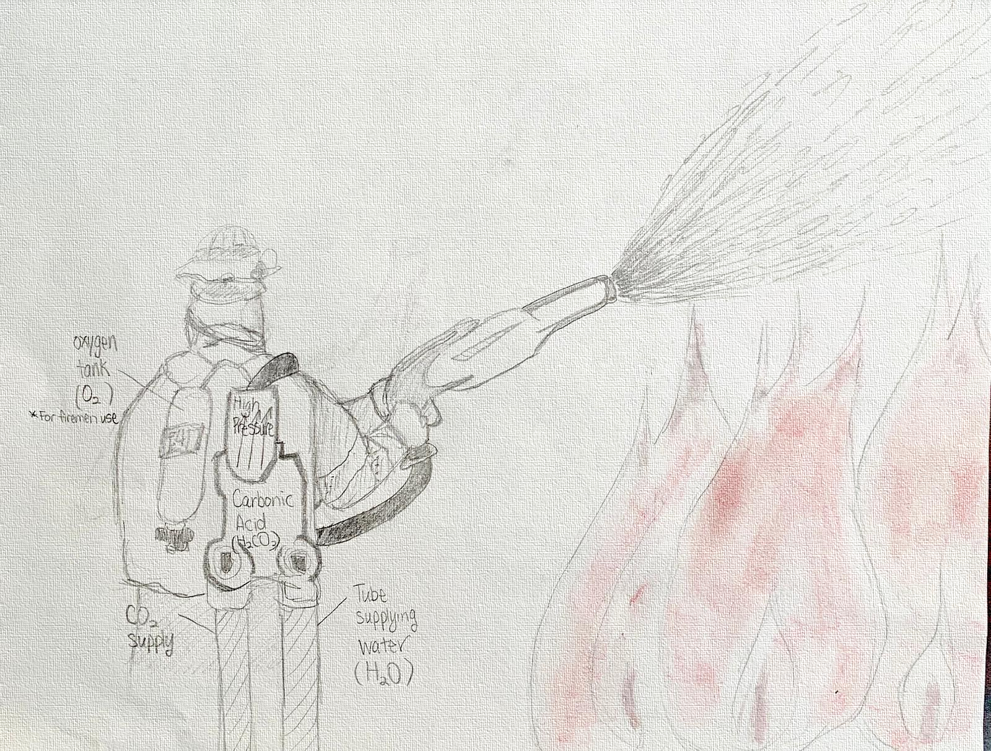


Extinguisher Approach
While CO₂ on its own is a dangerous asphyxiator, we found that its cousin, carbonic acid [H₂CO₃ is more effective at suffocating a fire. While it has its own downfalls to consider (pure gas & steam cause death), we found that carbonic acid has a high decomposition rate in the presence of water(rendering it harmless). Therefore, using carbonic acid is one of the most effective remedies of isolation of a flame from oxygen.
As it hits the fire zone, the flame will be covered in a gaseous cloud [CO₂ + H₂O →← H₂CO3] creating a blanket which will dissipate the oxygen in the air to suffocate the fire.
The second wave of extinguishing should be done with water to smolder any remaining flames and further cool down the vicinity of the wildfire. By doing so, not only do we prevent the area from being extremely flooded, but also increase the efficiency of the combatting extinguisher.
H₂CO₃
O₂ Tank
H₂O
CO₂

Slide 10
Hypothesis
If high levels of CO are produced during a wildfire and humidity & temperature also increase during a fire, then we can use these three factors to detect a wildfire in its initial stages.
If a pressurized solution of carbonic acid (in water)is able to displace enough Oxygen to suffocate the fire, and will dissipate quickly, then it can be used as a fire extinguisher.

Slide 11

Working Design
DHT22 Temperature & Humidity Sensor
MQ-7 CO Sensor
Aduino or Raspberry Pi microcontroller

Slide 12

Design Approach
Fireproof encasing
Thermoelectric Generators
(TEGs)
Xbee Wire Antenna
Dry Powder Fire Extinguisher Ball
DHT22 Temperature & Humidity Sensor
MQ-7 CO Sensor
Aduino or Raspberry Pi microcontroller
Max6675 Module K-type Thermocouple
Wrapped in vine for camouflage
Powerful mechanical legs to grip the branch

Slide 13

Design Approach
We finalized the design of our ABCOTH sensor as a large bug in order to camouflage it with its surroundings and at the same time ensuring maximum functionality.
The dark exterior attracts heat needed to power the TEGs, which will then activate the sensor during a distinguishable temperature fluctuation.
We used TEGs to power the sensor because if the sensor was online 24x7, the long-term effects of the Wi-Fi signals would cause serious damage to the plant and animal life around the sensors. Due to its autonomous powering, the sensor can be transported & used anywhere.

Slide 14
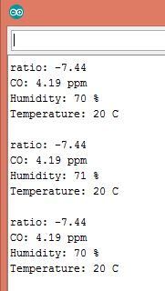
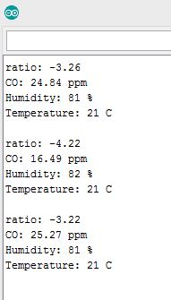
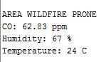
Observations
Normal (room temp.) readings
Normal (room temp.) readings

Slide 15
Observations
We found that of the three factors we used, CO levels and humidity were most accurate while the surrounding temperature was slow to rise.
Another observation we made was that although measured CO levels from a cigarette were 300 ppm, the CO would quickly disburse in an open environment, which was why we tested in both a room with various furniture and between shrubs. We found that CO levels disbursed at nearly the same rate and that the best testing

Slide 16
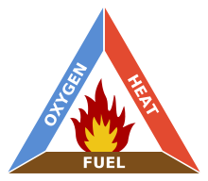
Inference
From our research, we infer that wildfires can successfully be detected by using three factors: temperature, humidity, and CO levels.
We targeted Oxygen from the fire triangle and
found that by coupling Carbonic Acid with water,
a blanket of water vapor and carbon dioxide
would be created, large enough to displace
oxygen long enough to suffocate the fire. This application is
for firefighters on land.

Slide 17
Citations
https://drive.google.com/open?id=14KSVMsIdlZz8uOJLuQbHQOawPPxA9urdu8LytIdT_YQ
http://www.fao.org/docrep/article/wfc/xii/0278-b1.htm
https://www.nasa.gov/image-feature/goddard/2018/agricultural-fires-seem-to-engulf-central-africa
http://www.abovetopsecret.com/forum/thread1164431/pg1
https://www.scientificamerican.com/article/carbonic-acid-gas-1853-04-02/
https://www.ncbi.nlm.nih.gov/pubmed/11822465
http://www.loerting.at/publications/loerting10-cphc.pdf
https://www.scientificamerican.com/article/carbonic-acid-gas-1853-04-02/
https://crosscut.com/2018/08/warning-breathing-wildfire-smoke-can-have-long-term-health-effects
https://www.mdpi.com/1999-4907/3/2/398
https://www.researchgate.com

